Slide 1

Hate Speech detection in the Comments of Social Media
Presented to, Presented by,
Spring Board Mentor Nikitha S
Shreyansh Kahate
Madhuri K

Slide 2
Content
1.Business Problem
2.Solution
3. Dataset Description
4. Data Visualization
5. Data Preprocessing
6. Tokenization and Embedding Techniques
7. Modeling
8. Evaluation metrics

Slide 3
Business Problem
The proliferation of online platforms has provided a space for people to connect, share ideas, and engage in discussions.
However, it has also led to the spread of hate speech, which can have serious social and psychological consequences.
This project aims to develop a deep learning model capable of detecting and classifying hate speech in textual content – comments from social media platforms.

Slide 4
Solution
To address the challenge of detecting hate speech on social media platforms, we developed a deep learning model capable of classifying comments into hate speech and non-hate speech categories. This model aids social media platforms in efficiently identifying and managing harmful content, ensuring that community guidelines are maintained and creating a safer online environment for users.
Develop a dataset: Curate a dataset consisting of text samples labelled as hate speech or not.
Pre-process data: Clean and pre-process the text data to make it suitable for training a deep learning model.
Build a deep learning model: Design and train a deep learning model to detect and classify hate speech.
Evaluate the model: Assess the performance of the model using standard metrics.
Deploy the model: Create a system that can be integrated into online platforms for real-time hate speech detection.

Slide 5

Dataset Description
Social media platforms frequently spread hate speech through textual content. Our dataset, sourced from the Hate Speech Curated Dataset on Kaggle is minimized and so includes 10,000 entries with an equal ratio of hate speech and non-hate speech comments. This balanced dataset contains text comments and labels indicating whether each comment is hate speech.
The Content column contains the input text and the Label column contains the input label 0 and 1.
“0″ means non-hateful
“1″ means hateful
link: https://www.kaggle.com/datasets/waalbannyantudre/hate-speech-detection-curated-dataset

Slide 6
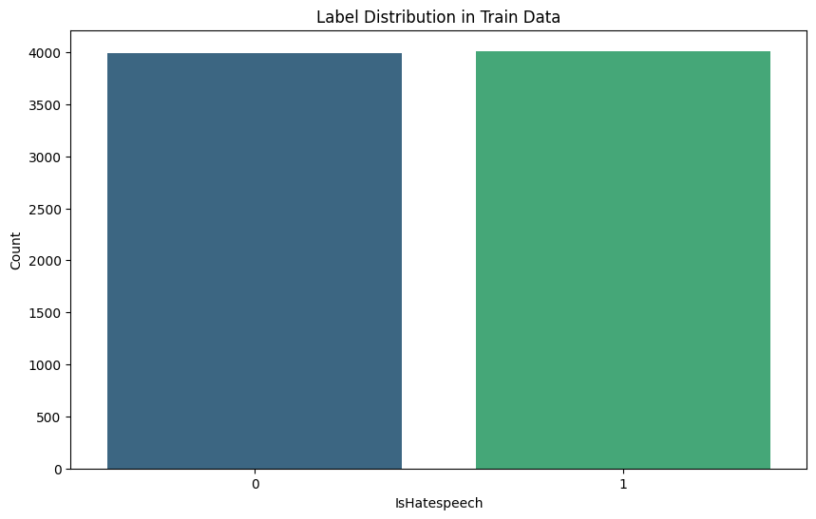
Data Visualization
The data distribution is quite balanced, with half of the dataset labelled as hate speech and the other half as non-hate speech.
The entire dataset contains approximately 10,000 rows, with about 5,000 labelled as 1 (hate speech) and 5,000 labelled as 0 (non-hate speech).

Slide 7
Data Preprocessing
The Preprocessing Involves various data cleaning steps and EDA for getting insights about the quality of the data.
Removing punctuations
Removing common Stopwords
Tokenization & Lemmatization
Reassembling tokens
Removing special characters and emojis
Removing URLs
Creating a feature for text length

Slide 8

Tokenization and Embedding Techniques
Tokenization Technique:
By comparing various tokenization techniques, we determined that word tokenization would work best for our model.
Word Tokenization: Common for languages with clear separation (e.g., English).
Thus, we used word tokenization for our model building.
Embedding techniques:
We tried various word embedding techniques such as word embedding, one-hot embedding, TF-IDF, Word2Vec, GloVe, and advanced pre-trained models like BERT and RoBERTa.
The pre-trained models were computationally heavy and provided similar results to TF-IDF.
Among all the techniques, TF-IDF was the best performing one.

Slide 9
Modeling
Machine Learning Model:
We tried TF-IDF embedding and used it to train various machine learning models such as Random Forest, Logistic Regression, SVM, and Naive Bayes Classifier.
We compared their evaluation metrics and found that the SVM model was the best performing one.
To optimize its performance, we performed hyperparameter tuning on the SVM model to achieve the best possible score for the metrics.
Support Vector Machine (SVM): It is a supervised machine learning algorithm used for classification and regression tasks. It works by finding the optimal hyperplane that maximally separates the classes in the feature space.

Slide 10
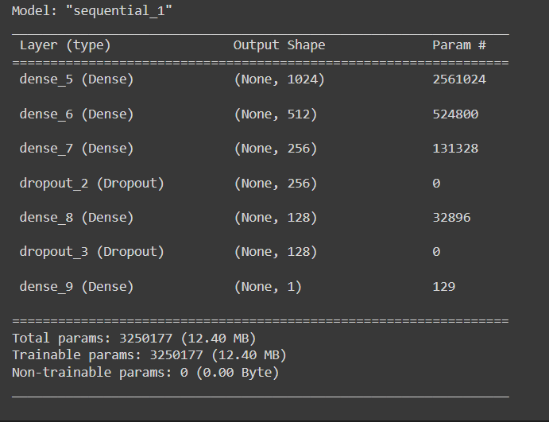
Deep Learning Model
We tried to build different deep learning models using LSTM, Bidirectional LSTM, CNN, and their various combinations.
We compared their performance metrics to determine the best model.
We also experimented with different optimizers and activation functions.
The best deep learning model chosen through this experimentation is shown below.

Slide 11
Evaluation Metrics
Accuracy measures the proportion of correctly classified instances out of the total instances and gives an overall effectiveness of the model.
F1 Score is the harmonic mean of precision and recall, providing a single metric that balances both the false positives and false negatives.
Precision is the ratio of true positive predictions to the sum of true positive and false positive predictions, indicating the accuracy of positive predictions.
Recall (or Sensitivity) is the ratio of true positive predictions to the sum of true positive and false negative predictions, measuring the model's ability to identify positive instances.

Slide 12
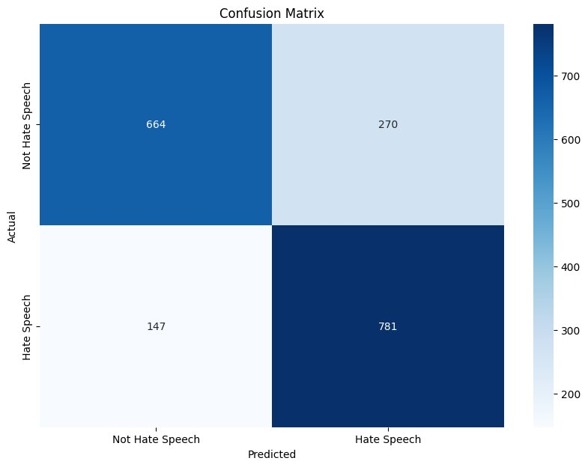
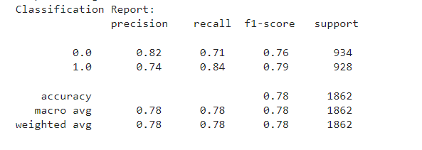
Best Model Evaluation Metrics:
Deep Learning Model Evaluation Metrics
Metrics | Score
Accuracy | 0.77604726100966
F1 Score | 0.78928751894896
Precision | 0.74310180780209
Recall | 0.84159482758620

Slide 13


